Slide 1

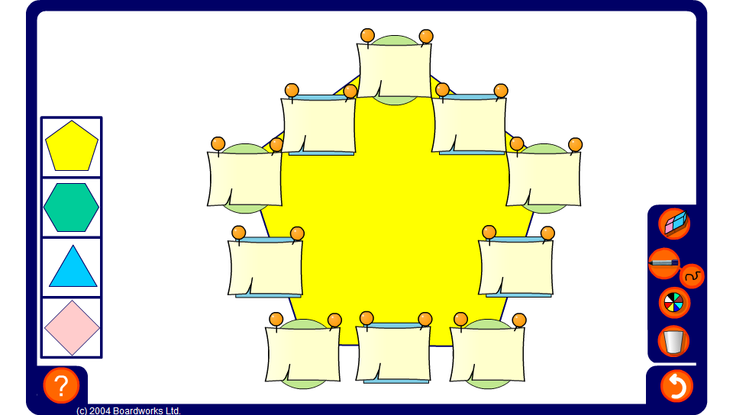


Arithmagons – decimals
Notes:
Use the arithmagon on this slide to practise adding and subtracting decimals. Press reset for a new puzzle or change the shape of the puzzle by selecting one of the shapes on the left.

